Slide 1
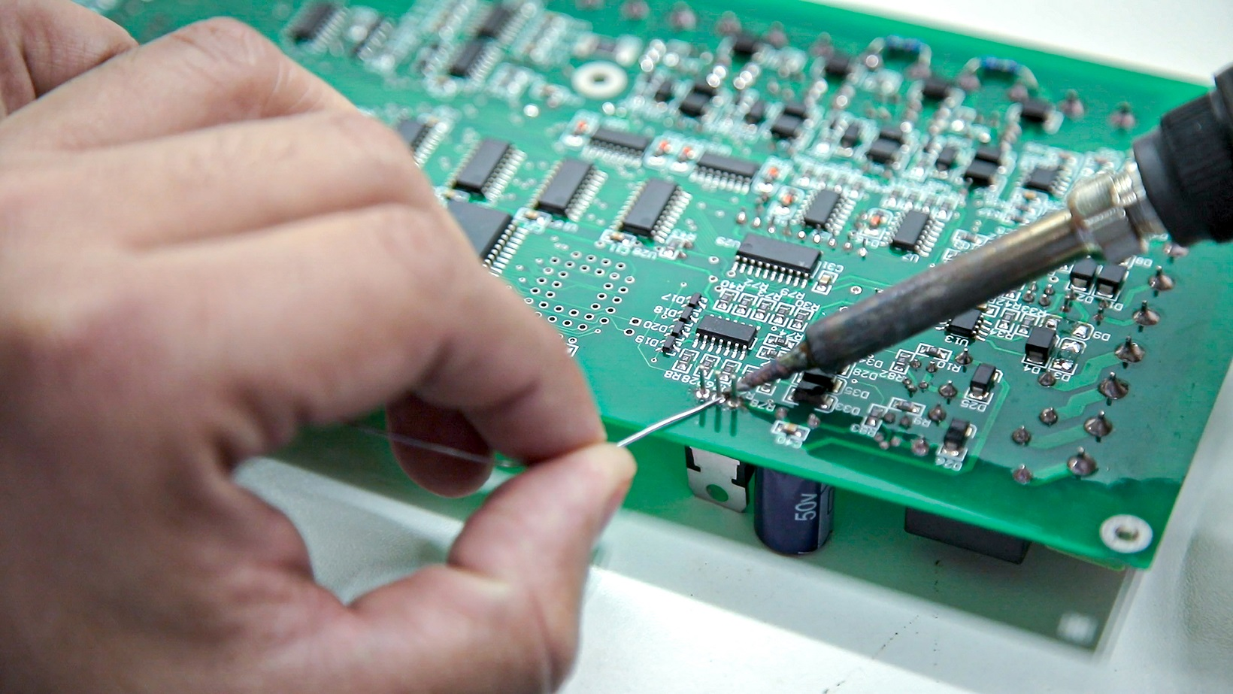
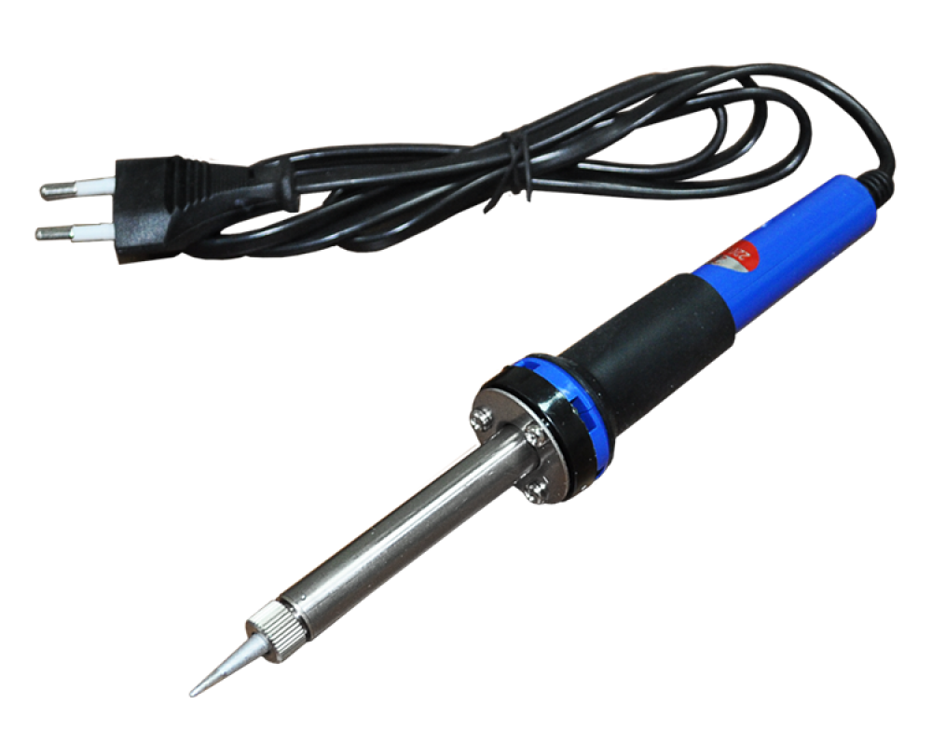
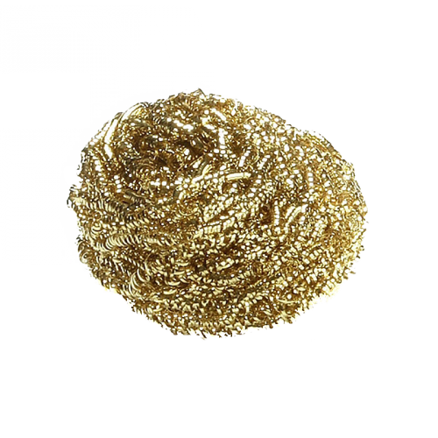
Soldering
SMC Engineering Club

Slide 2
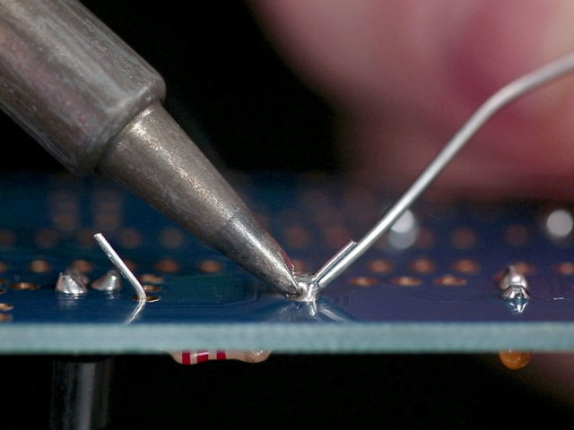
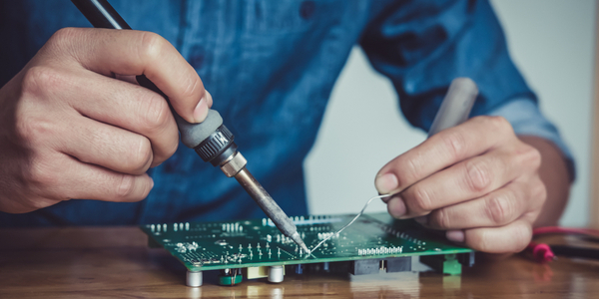
What is Soldering?
Soldering is a joining process used to join different types of metals together by melting solder. The melted solder then allows for a connection to be formed or for security of a wire to stay in place, which is how we’ll use it today for our activity.

Slide 3
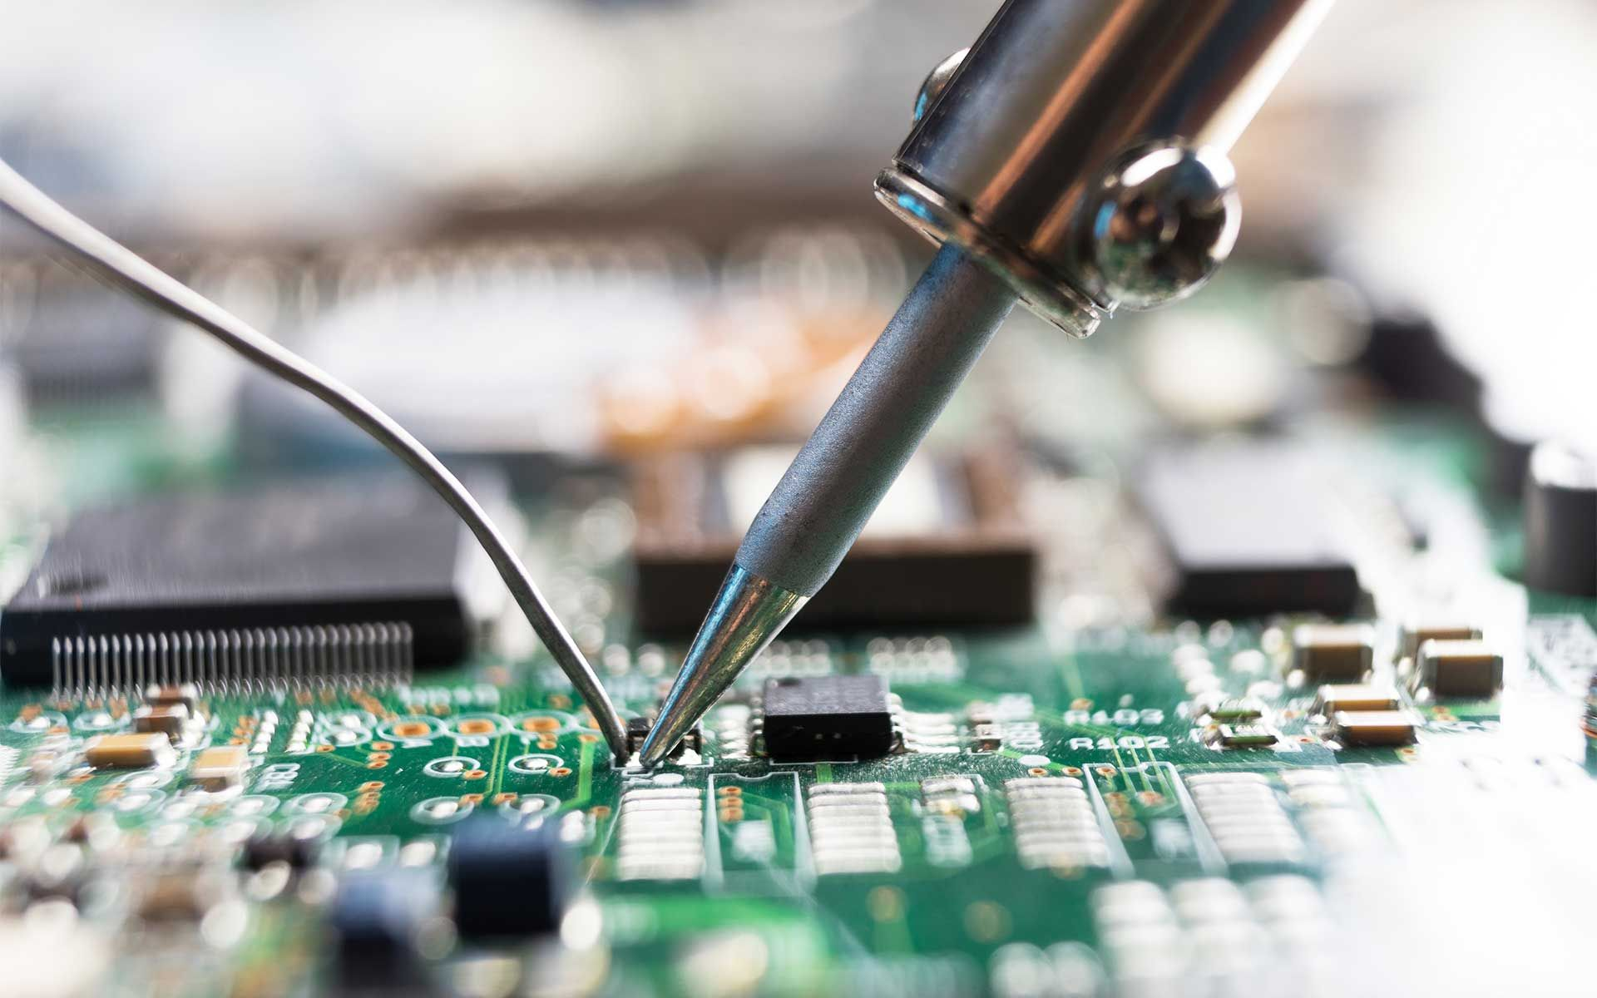
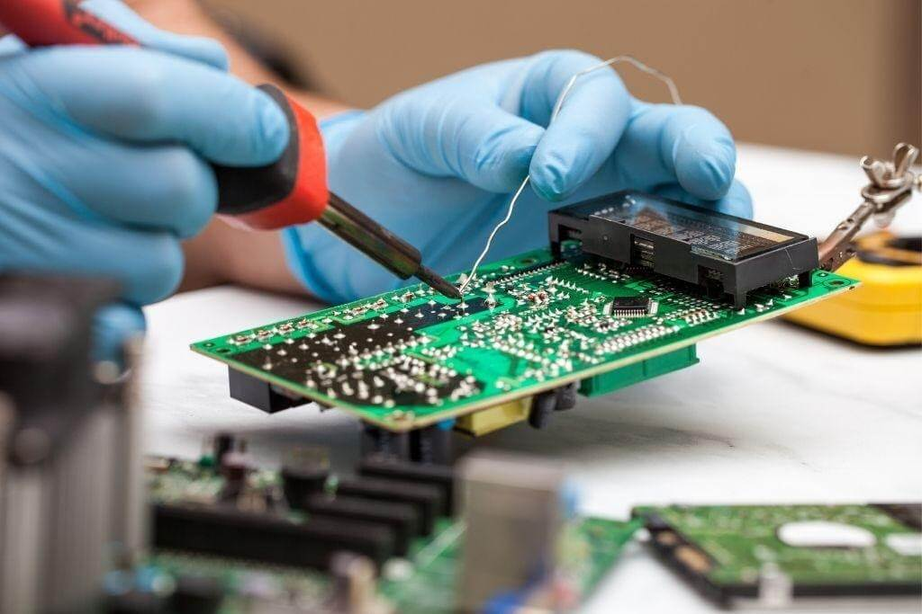
What is Soldering Used For?
Soldering is used in electronics for creating connections on circuit boards like so:
These connections allow for the two base metals to share a conductive bond. This conductive bond allows for mechanical stability and an electric pathway can be facilitated between those two pads. The pads purpose is to create circuit connections

Slide 4
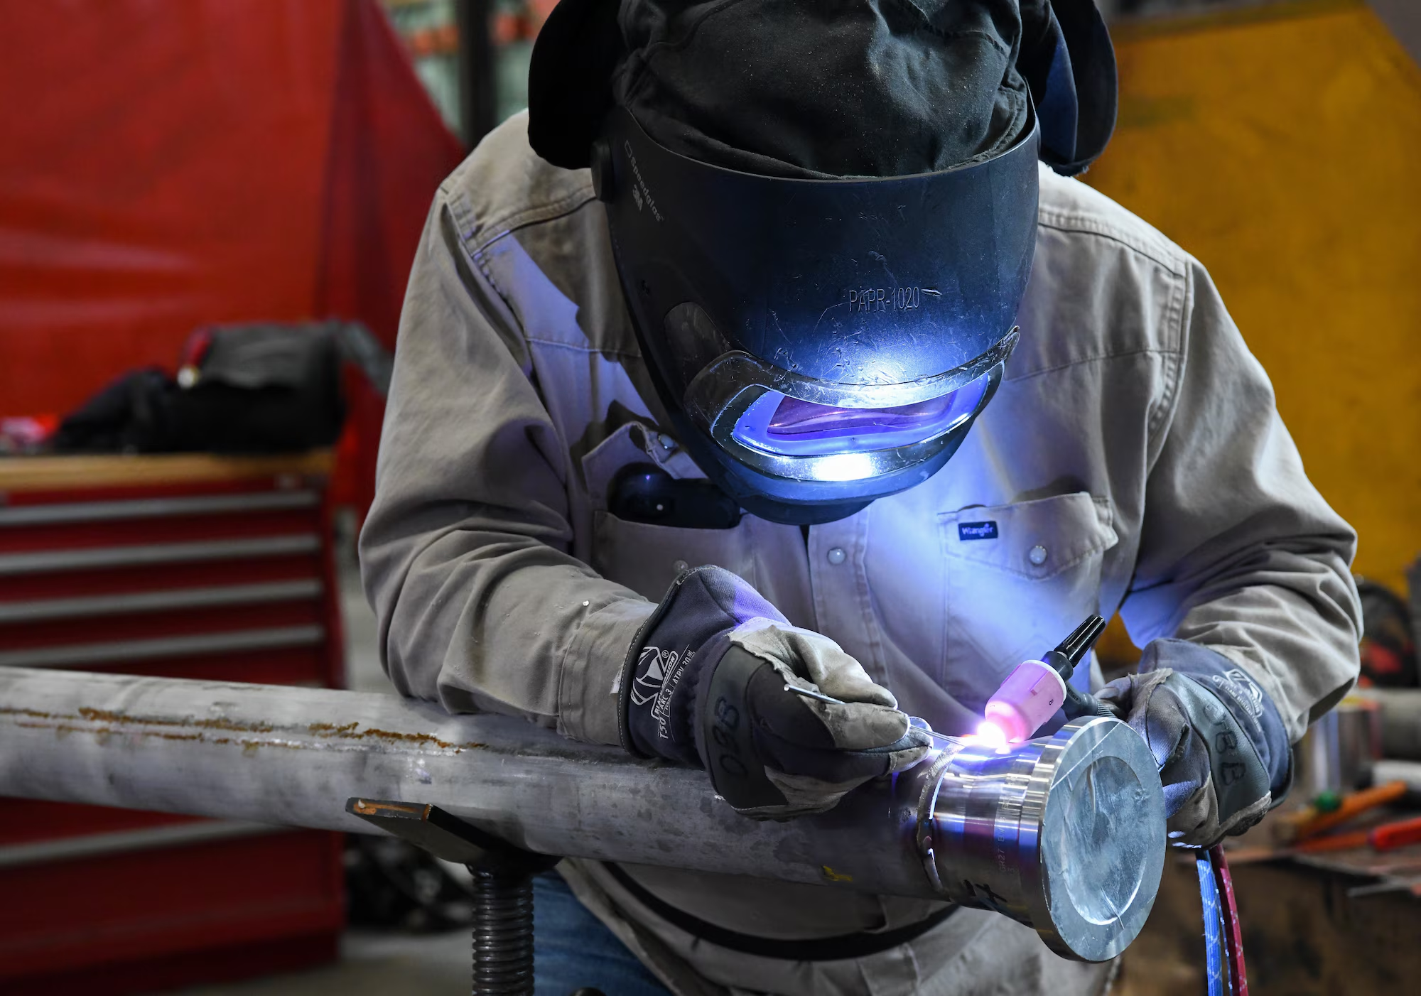
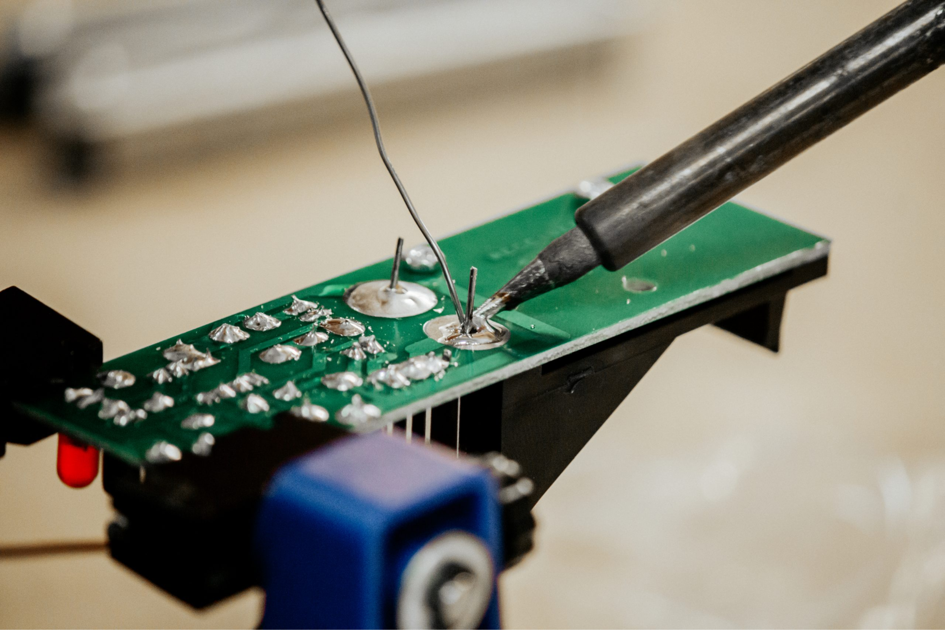
Soldering Vs. Welding, What’s the Difference?
Soldering: uses low-temperature heat to melt a filler metal that is used to bond base metals, like on circuit boards, in order to form a literal connection between the two base metals. General usage for soldering is electronics and circuits.
Welding: uses high-temperature heat to melt and fuse metals together.General usage is for construction and automotive, for example.

Slide 5
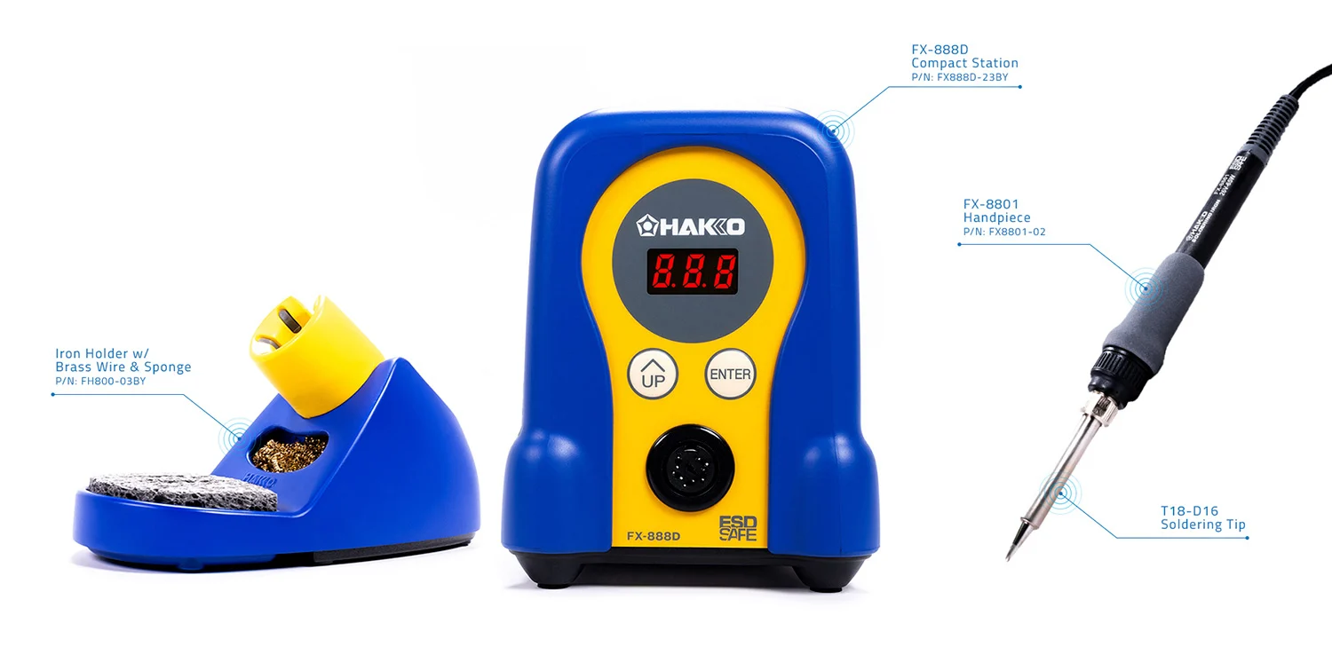
Soldering Iron Components

Slide 6
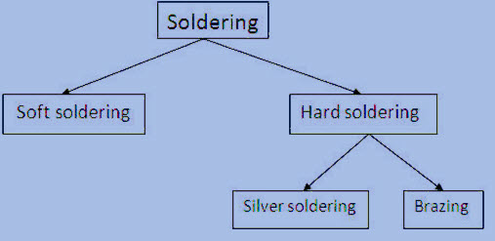
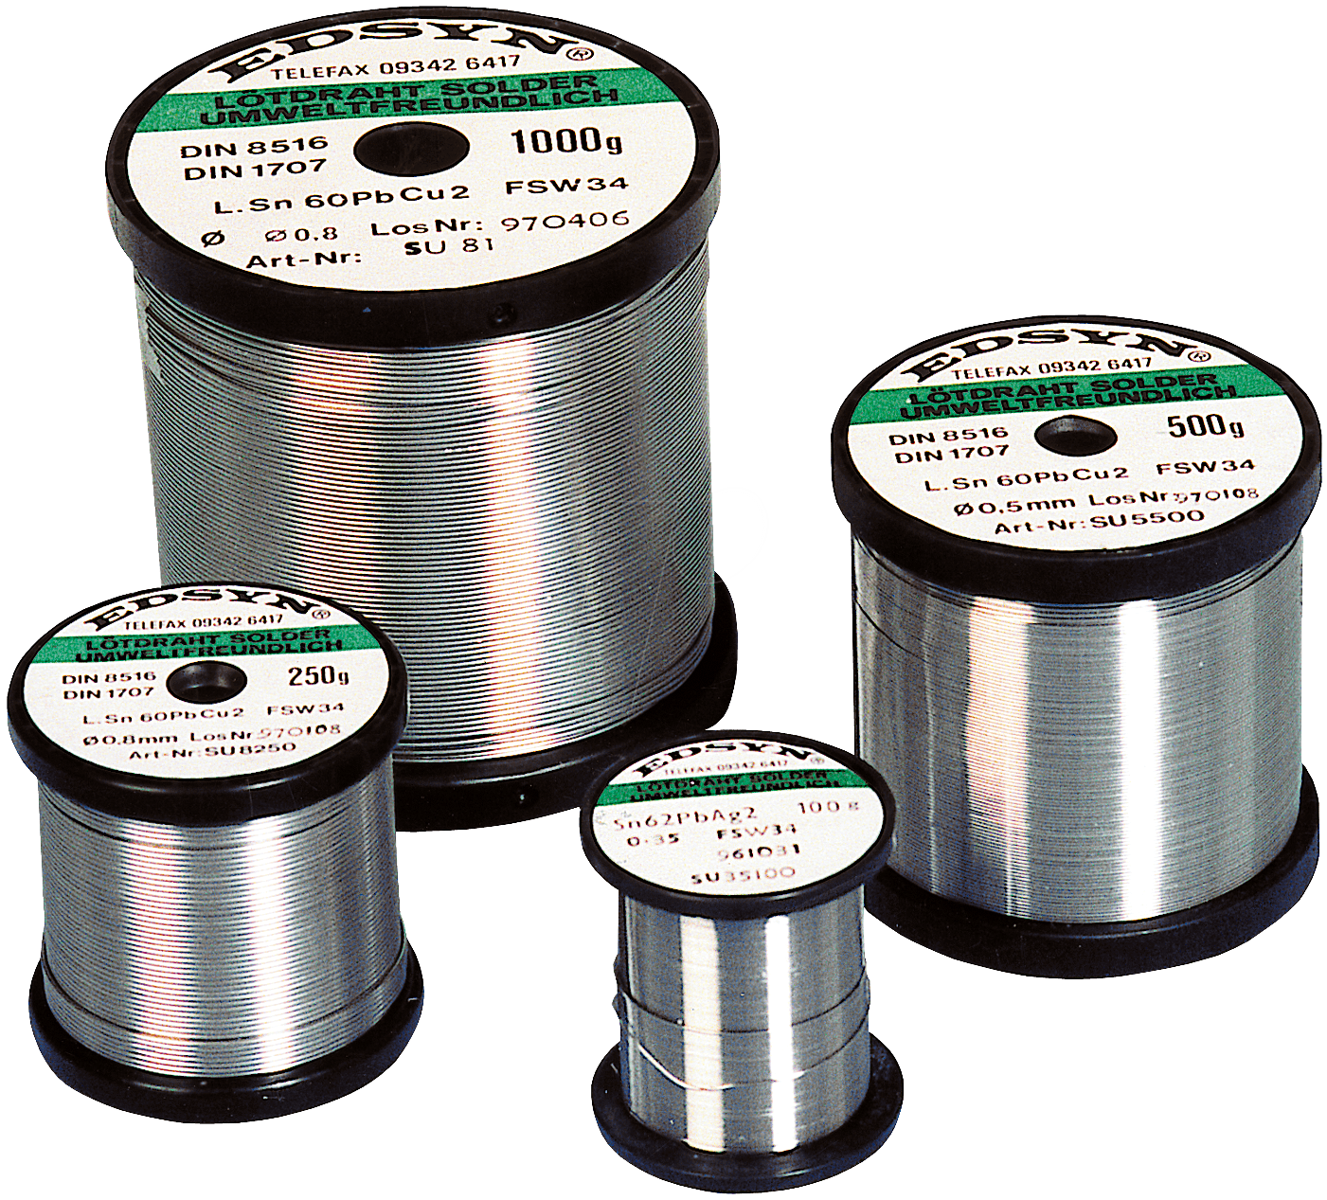
Solder
Comes in the form of wire rolled up.
Different diameters of wire depending on application.
Each alloy has different melting point, strength, and purpose.
Types of Solder:
Lead-Based Solder
Toxic, lower melting point
Traditionally used for electronics
Lead-Free Solder
Non toxic, Higher melting point
Used when specific health regulations need be met
Silver Alloy Solder
Higher percentage of silver
Stronger than above alloys
Higher melting point

Slide 7
How to solder
Mount the component. Securing it by bending the wires about 45 degrees.
Heat the iron
To about 400 degrees C*
Tin the tip of the Iron
“Tinning” Applying a little bit of solder to the tip. Allows for better heat transfer.
Heat the Joint.
Touch tip of iron to the joint. At an angle about 45 degrees.
Holding it there for 3-4 seconds.
Apply Solder to Joint
Apply the solder to the joint. Not to the iron.
You want the joint to be hot enough to melt the solder when touched.

Slide 8
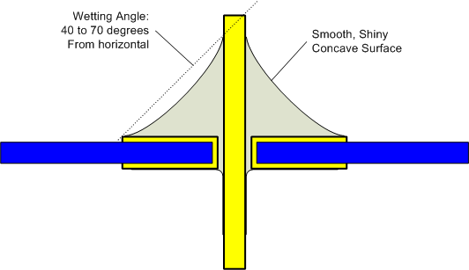
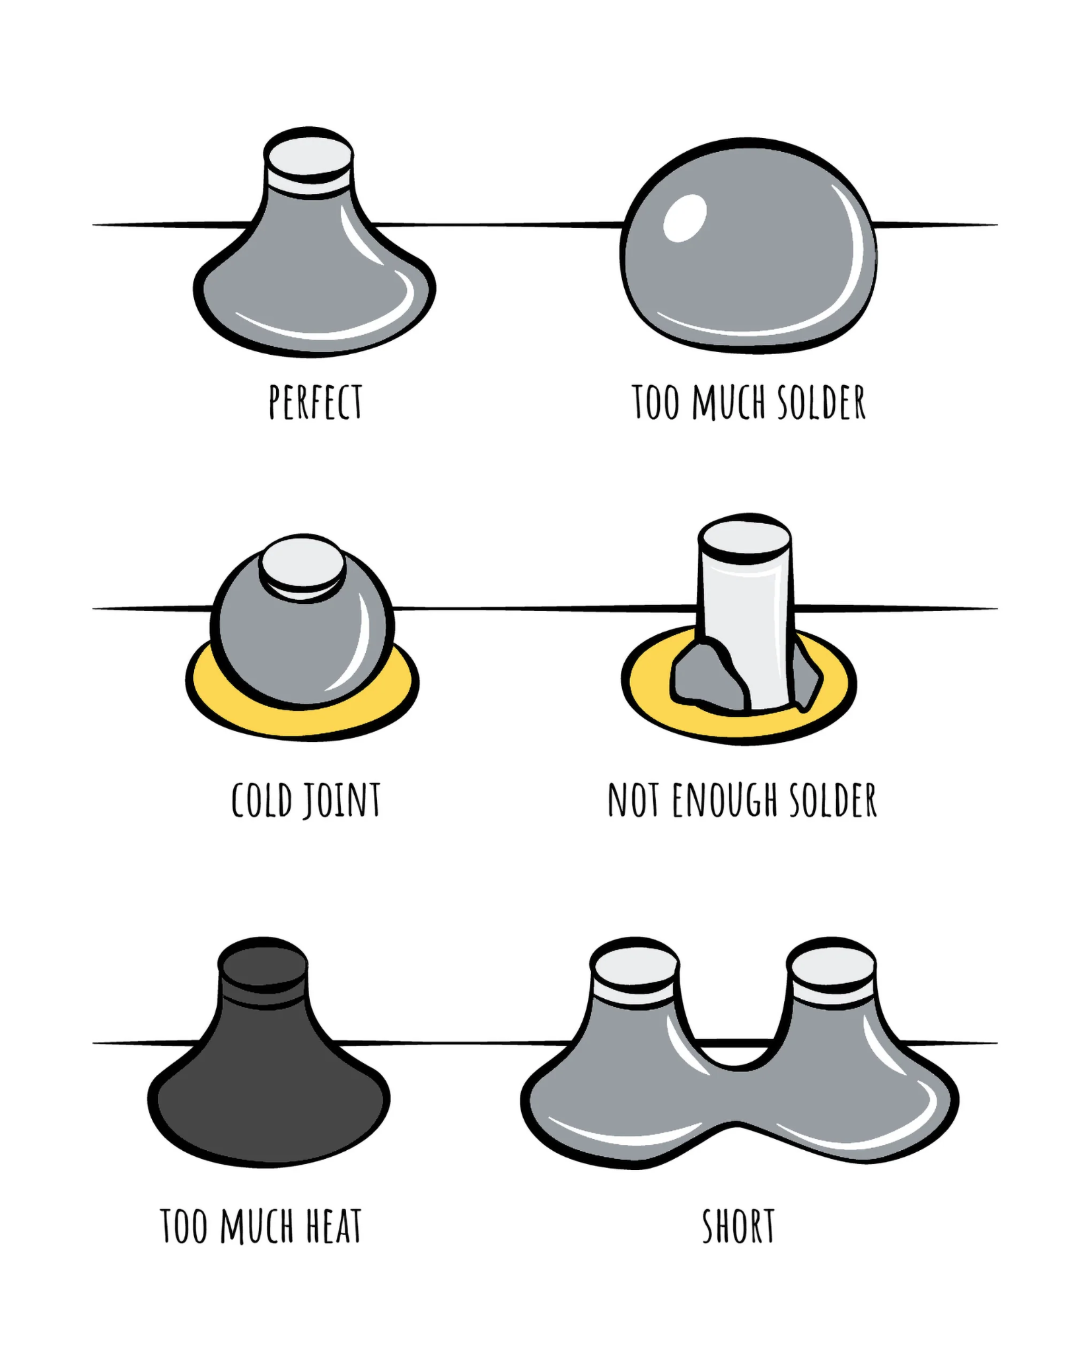
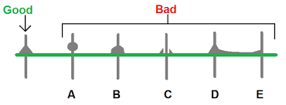
Good soldering vs. Bad soldering
Good wetting: The concave shape proves that the solder has flowed properly and created a full connection with both the pin and the pad.
Strong joint: The smooth, concave fillet is the result of the solder adhering to the metal surfaces, which indicates a strong and reliable joint.

Slide 9
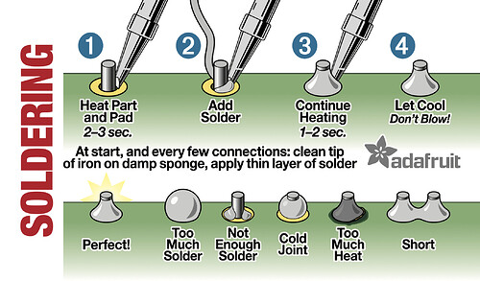

Slide 10
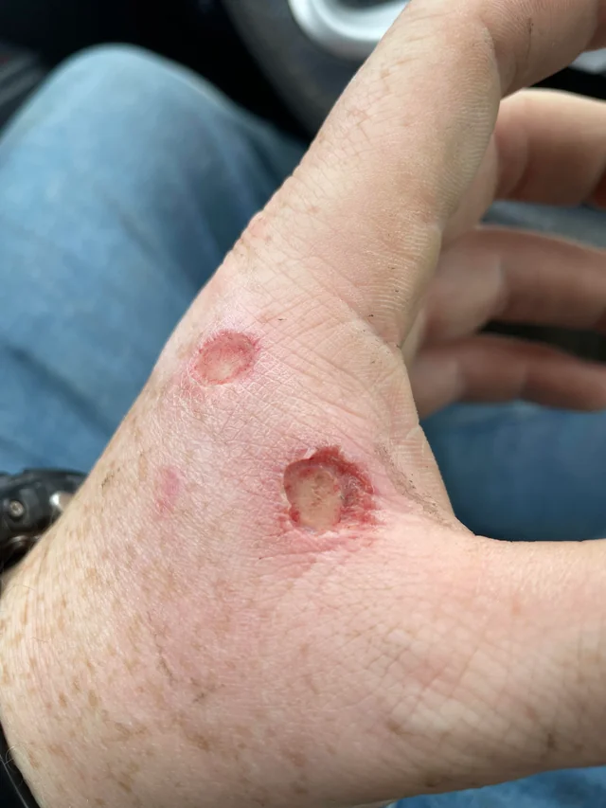
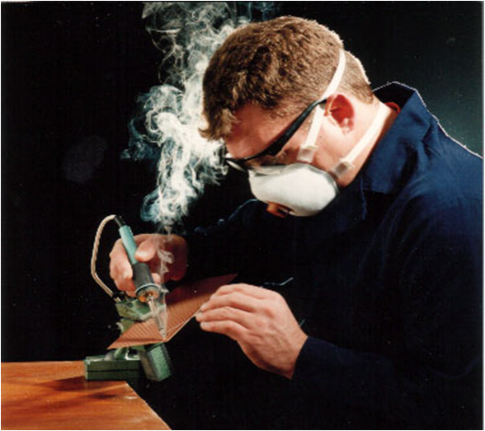
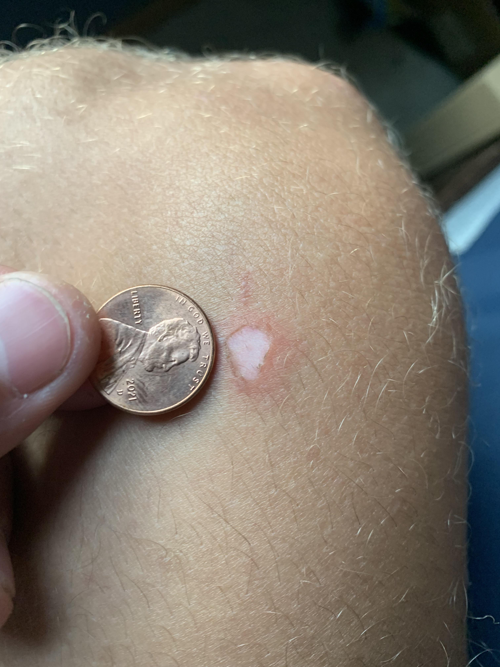
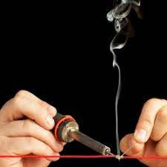
Safety
Always assume the irons are hot because they often are!!
Always solder using a fan or in a well ventilated area as soldering produces fumes.
EMPHASIS: Soldering fumes are not just regular fumes like automotive fumes or fire smoke, they contain irritants and toxic substances that can cause eye irritation.
EMPHASIS: these rods are hotter than the inside of a hot oven, you can get 3rd degree burns easily if you are not careful

Slide 11
Good Practice
When the soldering iron is hot but unused, keep some solder on the tip. When hot, it can accelerate the oxidation process of the iron. When you keep solder on it, it will oxidize the solder and keep the iron safe. When you need to use the soldering iron again, you can always clean the solder off and get a new bit. This protects and extends the lifespan of soldering iron tips.

Slide 12

Soldering Kit Instructions:
https://cad.onshape.com/publications/e3bdcfd963f6c27ca68a8dd5/w/d9d0b5db2dadaf990935f3dc/e/d23a04c36aac5381c6cb9388
For instructions go to: Or Scan the QR Code:
https://learntosolderkits.com/
Then click on instructions
Find the matching walkthrough for your kit.

